Slide 1
Dishoos
Solving Your dish issues
Notes:
Rubrics:
Quality of Idea (creative, compelling, unique)
Quality of Development (involvement of relevant stakeholders, feasibility, value proposition)
Quality of Presentation (graphically and verbally)
Quality of Service System (User journey, iterations, touchpoints, stakehodlers at each stage)

Slide 2
Eating out: through the eyes of a user

Slide 3
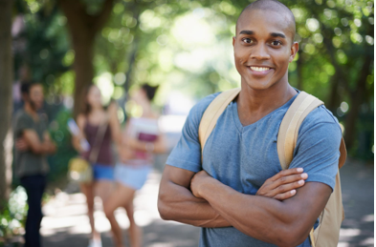
simon
Simon
Age: 21
Lives in London
Often goes out for Dinner with his Girlfriend at new Trendy Restaurants

Slide 4


Slide 5
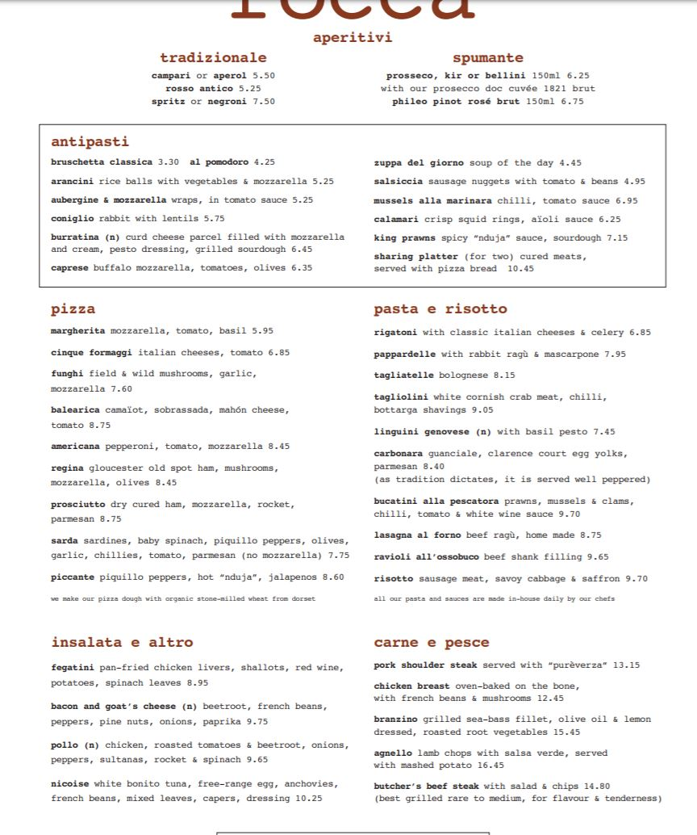
Pictures of cancerous menus

Slide 6
Eating out = 2 big decisions

Slide 7
Eating out = 2 big decisions
Where to eat and what to eat

Slide 8
Where to eat, what to eat
Where to eat:
What to eat:
Google Maps
Yelp
Tripadvisor
Foursquare
+ many more!
???

Slide 9
The problem
How might we help customers choose the best restaurant and best dishes to have the best restaurant experience?
Obstacles – waiter reccs not always honest
Menu – no pics, not enough info
Hcd techniques used to solve
Notes:
Asking waiters is a pain point, having to wait for them, may not have the time to go through each dish etc

Slide 10
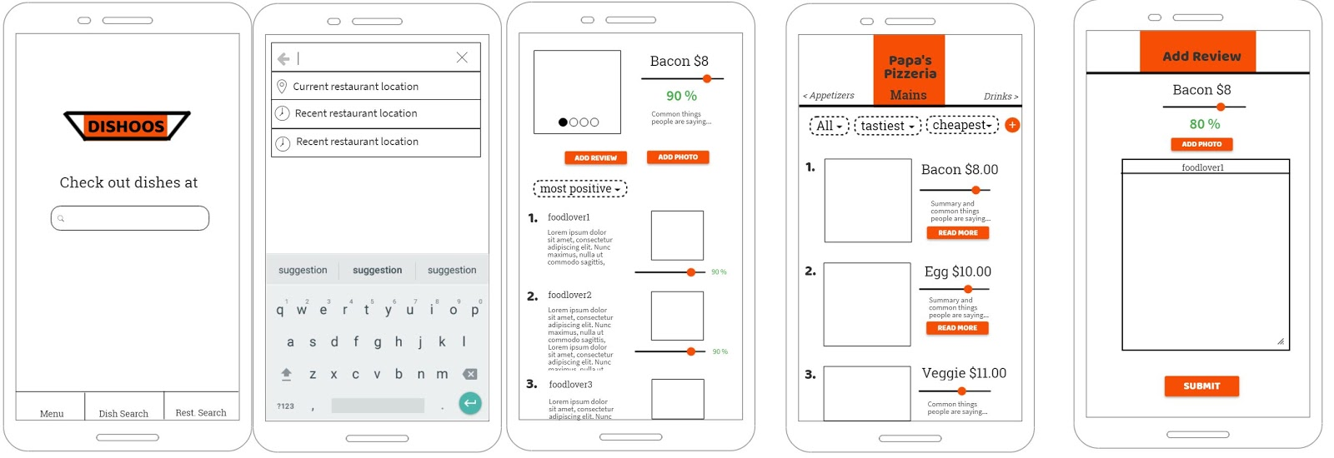
Our Solution - dishoos
Mobile app
Reviews-based Recommendation of dishes/restaurants
Supercharged menu on your phone
Rely collective experience of those before you
Detailed description
You should give a more detailed explanation of the expected uses of your application. It should
be clear how users will interact with your system and what benet this will provide to them. It
should also be clear that the Human Centred issues identied in the problem statement have been
addressed.

Slide 11
Target users
Young Adults in metropolitan Cities who eat out
(Restaurant owners)

Slide 12
demo

Slide 13


Slide 14
Add review

Slide 15
Research
Target Demographic Research
Agreed that it was a problem
Split between choosing a restaurant for a dish or choosing a dish for a restaurant
We focused on the latter, but not neglecting the former
Restaurant Owner
Mentioned it was useful for young adult patrons of restaurant
Data could be useful in tweaking dishes/menu

Slide 16
technical
Languages+frameworks
Structure+implementation

Slide 17




Languages+frameworks

Slide 18
Justifications + alts considered
React Native
Node + Express
Works on both Android and iOS with little platform dependent code
Using Expo allows deployment to Expo store rather than having to build an APK
There are other native development alternatives (e.g Ionic, Xamarin)
Same language on backend as frontend
Well established tools for web development

Slide 19
Justifications + alts considered
Postgres
SQL was a good choice as our entities followed a clear relational structure
Postgres as it was the SQL engine provided by DOC

Slide 20
Structure + implementation
Api Server
Main logic occurs in routes which manage each entity (e.g. restaurant, reviews).
Each route performs SQL queries
using knex js engine
knex
HTTP
Mobile Application
Consists of MVC components
Roughly organised into pages which have more complicated logic separated into it’s own component
Database Server:
Production database on DOC server
Testing and dev dbs locally

Slide 21
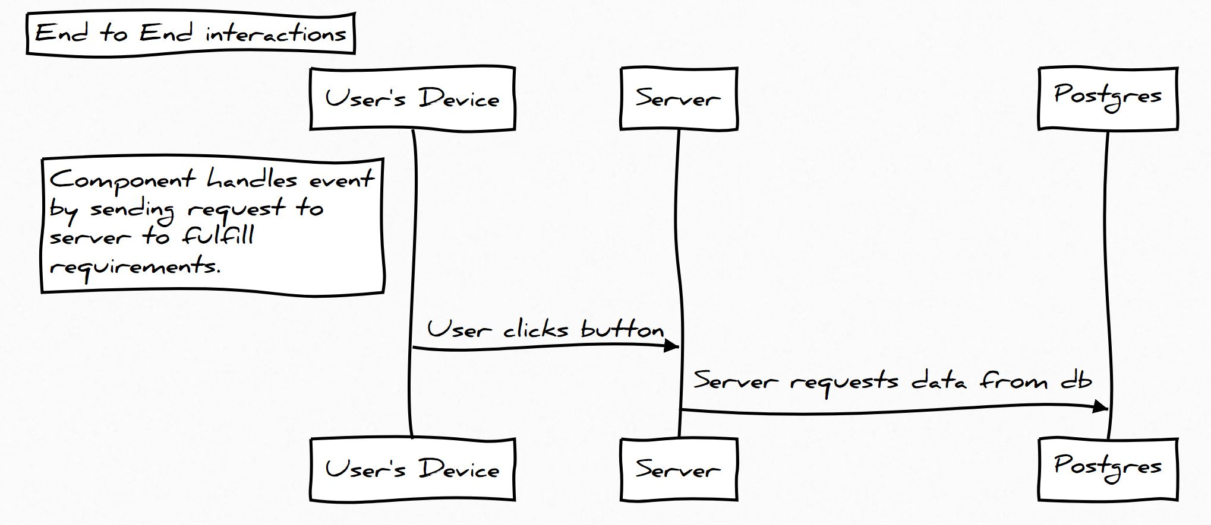

Slide 22
development

Slide 23
Mock up

Slide 24
Our value proposition
Providing Helpful Information for Customers
Choosing the Right Dish

Slide 25
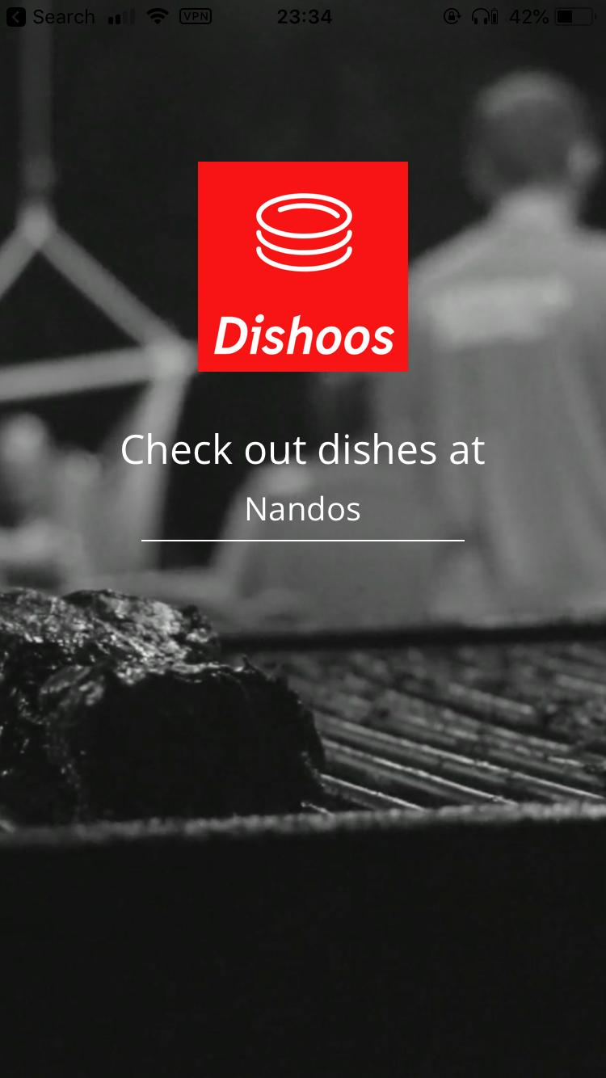
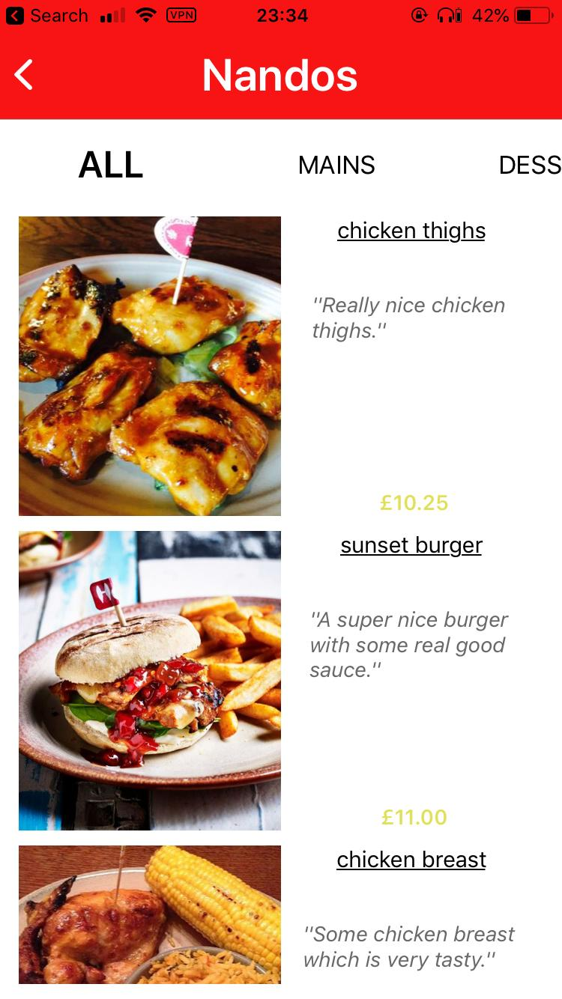
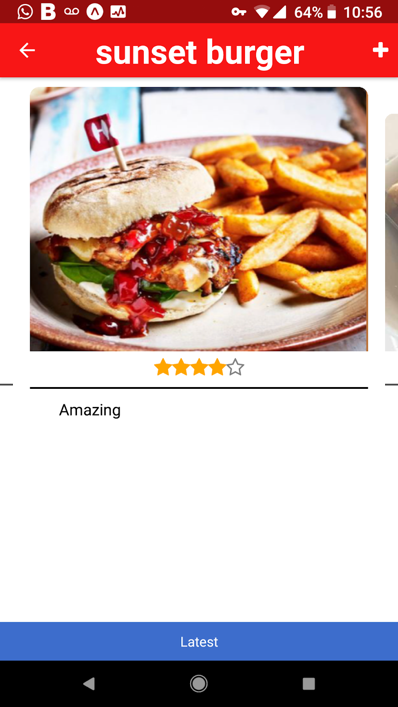
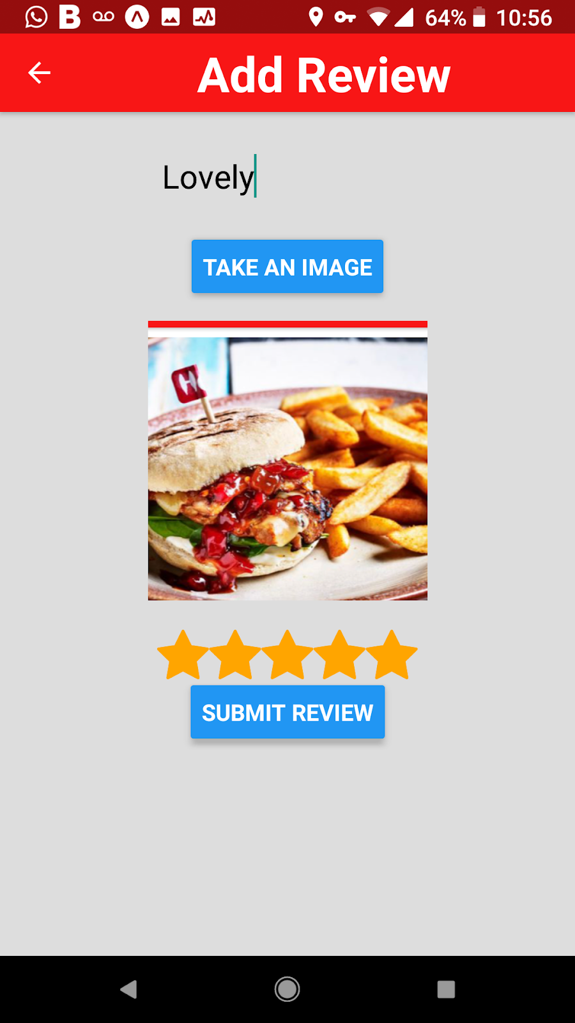
Iteration 1

Slide 26
Feedback from users
Dangerously ugly – fonts, colours, everything
Unintuitive menu navigation – not swipeable
Draw opinions from their friends – extra information such as if friends have similar taste
Ability to filter dishes based on criteria – food preferences

Slide 27
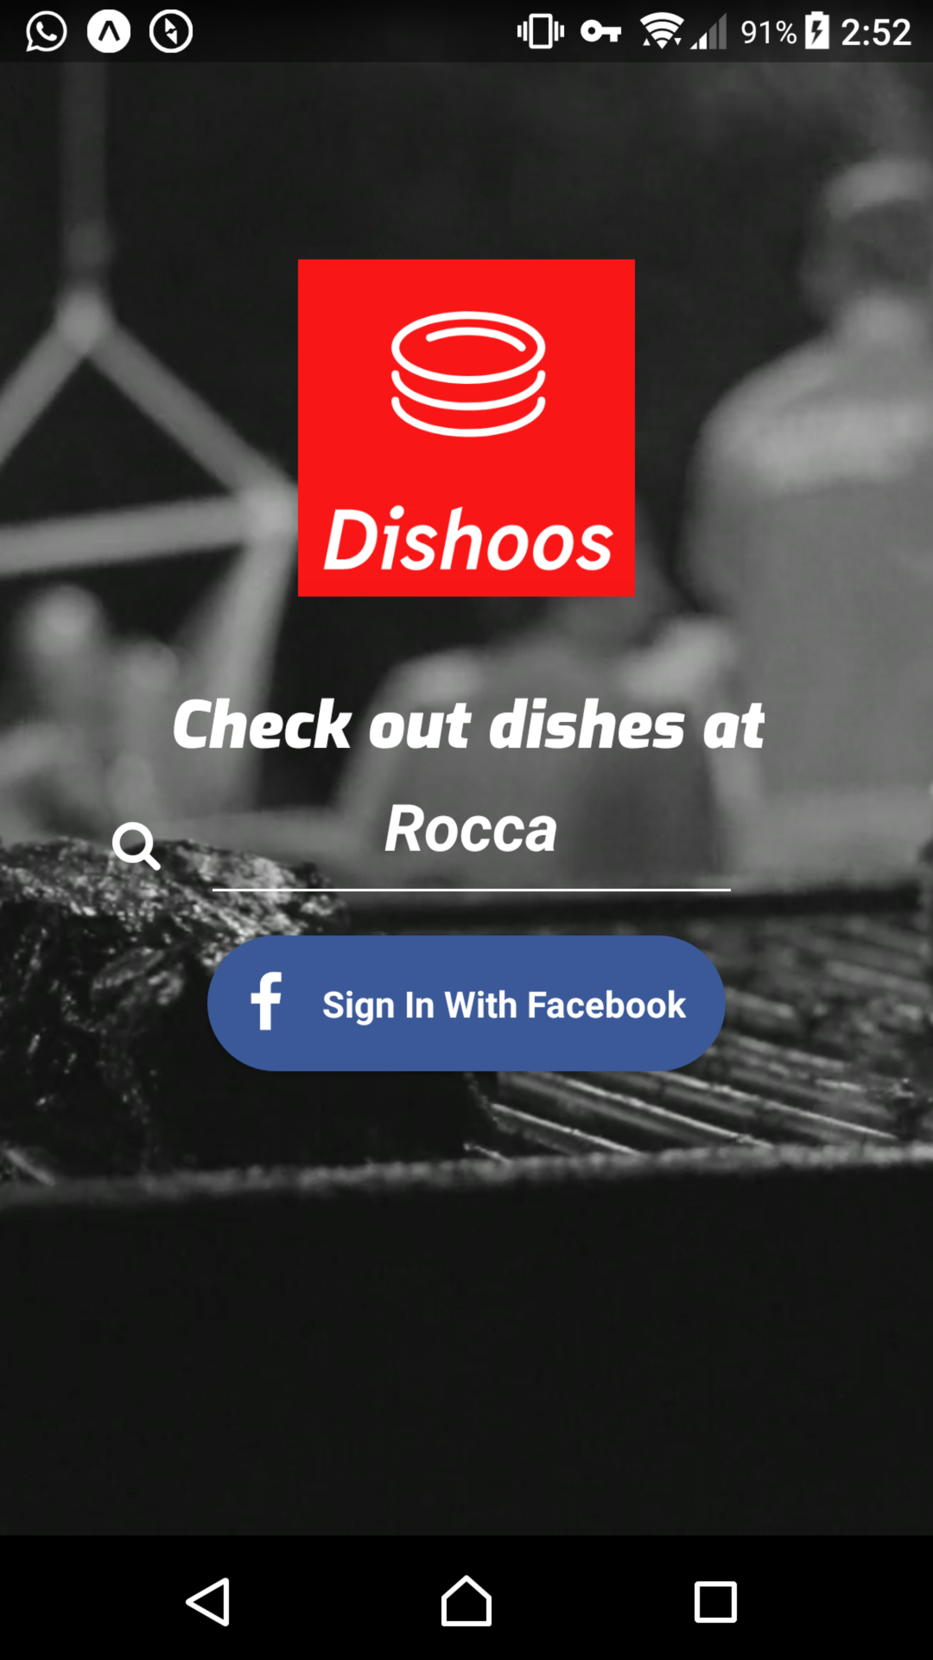
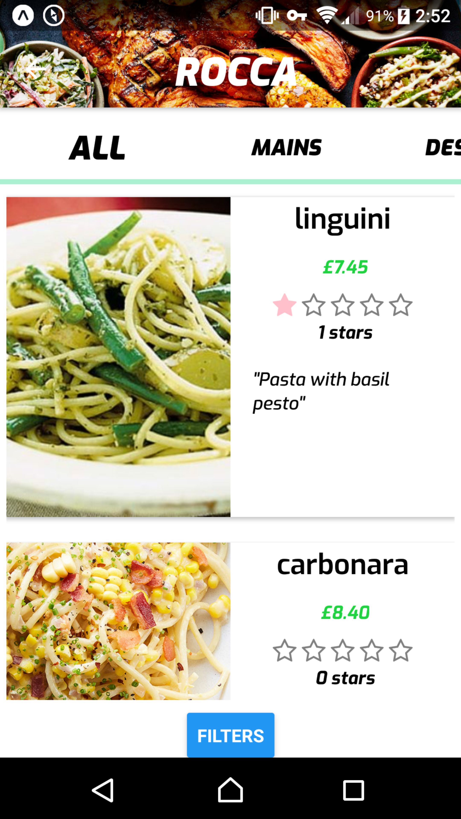
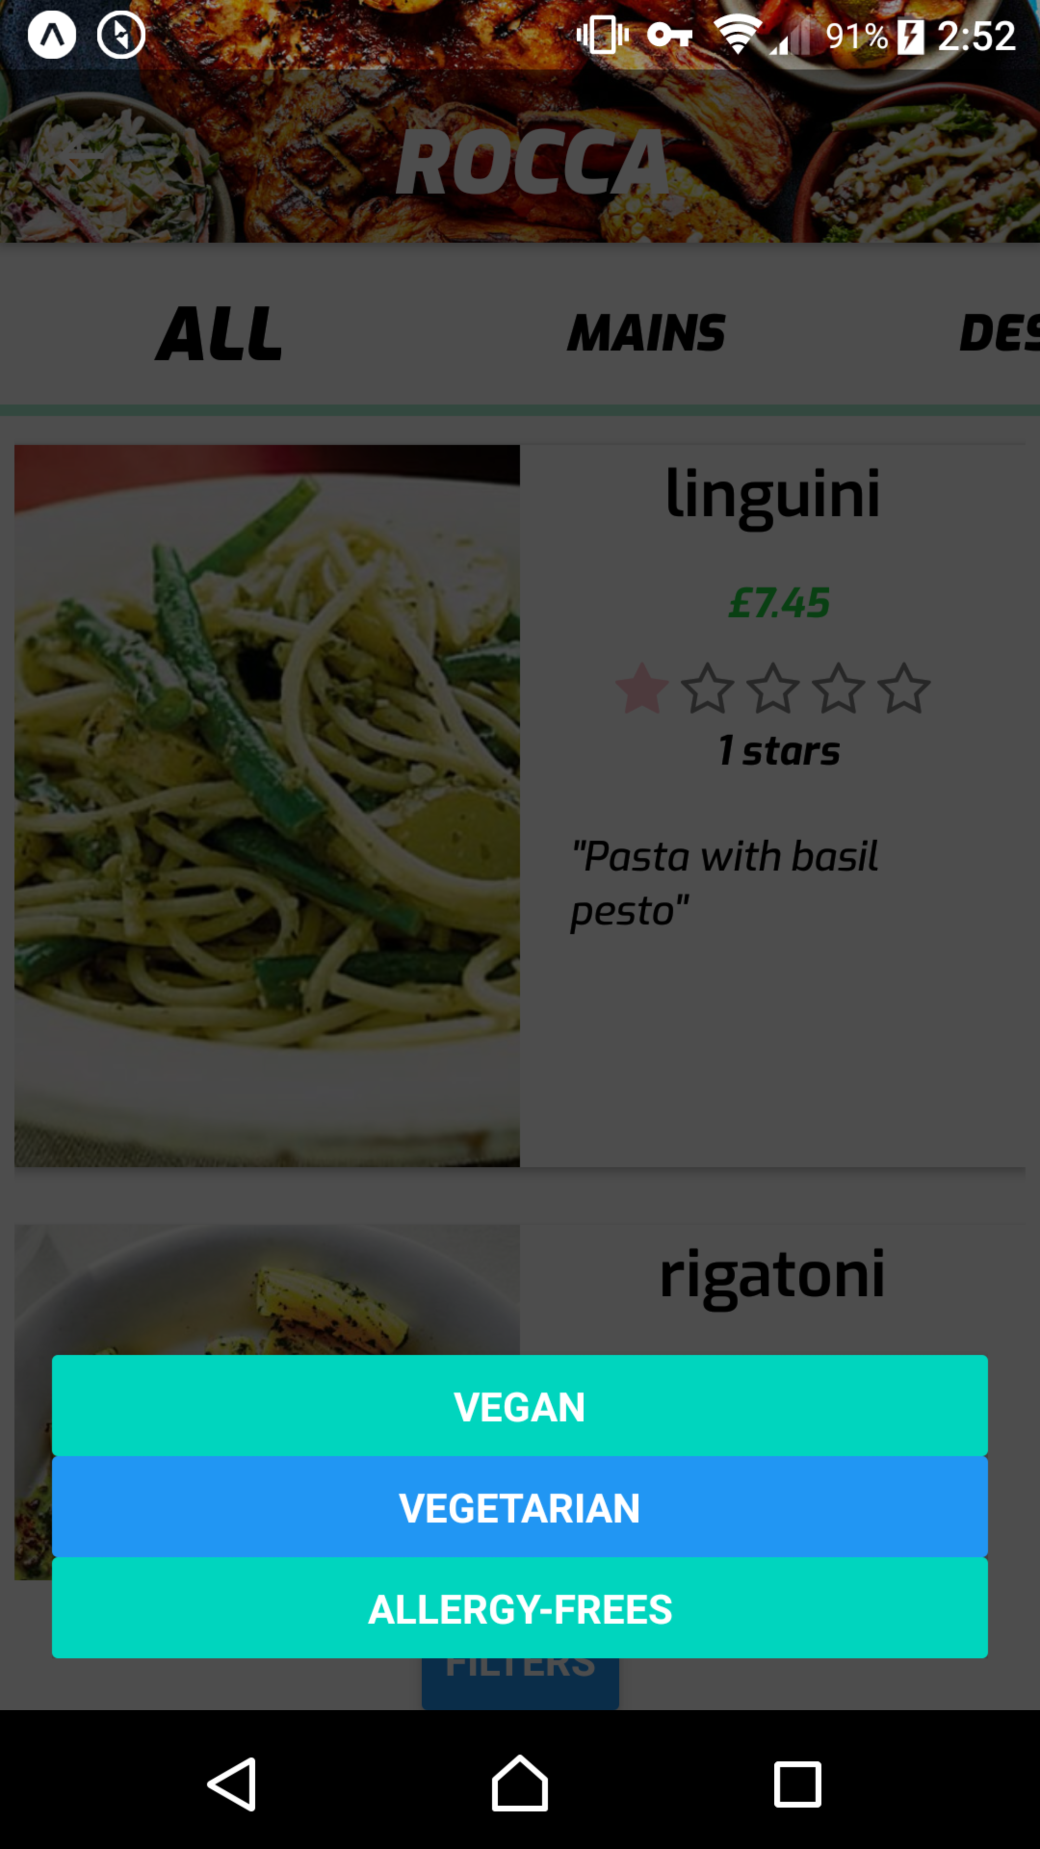
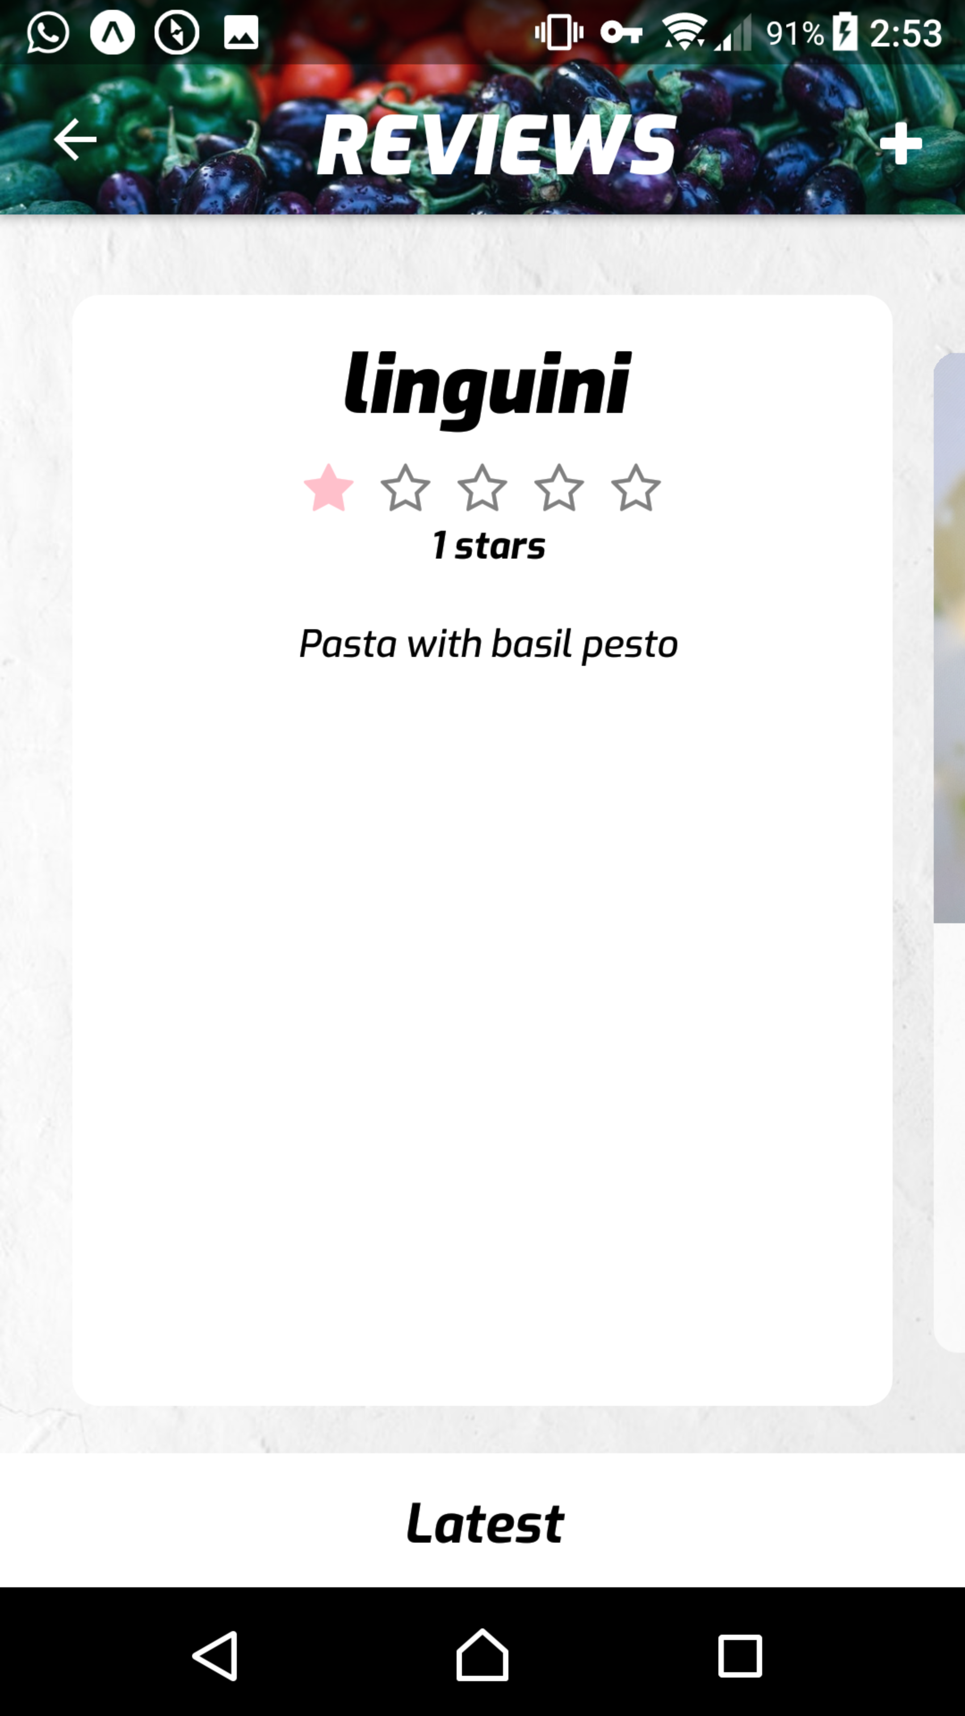
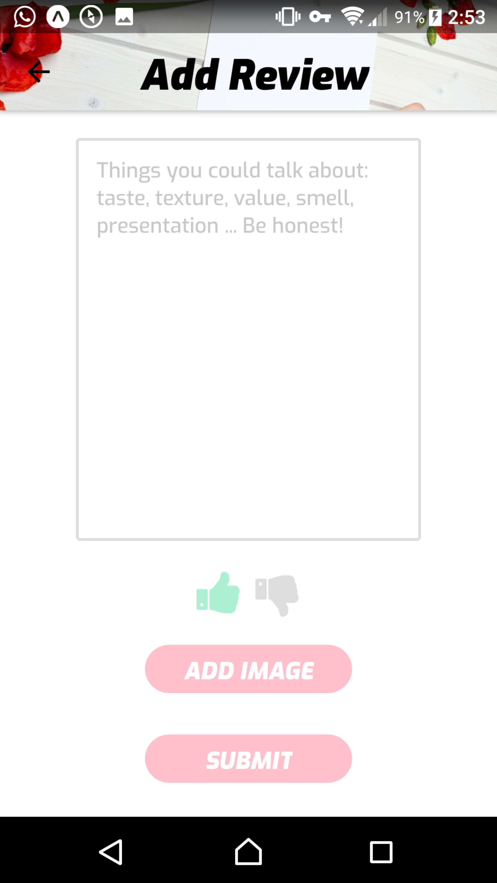
Iteration 2

Slide 28
FEedback
UI Is neat and tidy
Swipe-able menu makes it easy to use
Metrics done at Rocca show quicker time to navigate menu (show data?)

Slide 29
demo
Filters + facebook integration

Slide 30
evaluation
Reflection + the future

Slide 31
reflection
What we did
What we didn’t do

Slide 32
reflection
What we learned
What we would do different

Slide 33
Reflection - overall

Slide 34
The Future
Business integration
Talk to real businesses to see how the app can help them
Potential usefulness of data for them to tune their menu
Dish search, web portal, menu search

